Slide 1


Terrestrial Group Progress
All-Hand Meeting
Dec 2, 2011

Slide 2
Working Group IB: Terrestrial
Terrestrial Team
*Jennifer Adam, WSU
Sarah Anderson, WSU
Janet Choate, UCSB
Dave Evans, WSU
John Harrison, WSU
Mingliang Liu, WSU
Keyvan Malek, WSU
Justin Poinsatte, WSU
Kirti Rajagopalan, WSU
Julian Reyes, WSU
Claudio Stöckle, WSU
Christina Tague, UCSB
Jun Zhu, UCSB

Slide 3

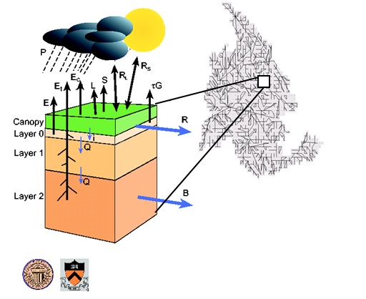
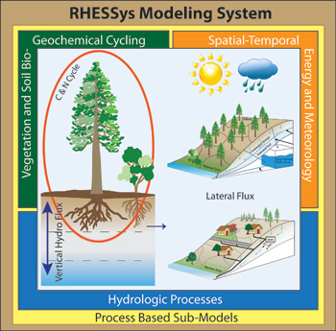

Models in BioEarth-Land
VIC: large-scale physical hydrology
Streamflow routing
CropSyst: point-scale cropping systems
ColSim: Reservoirs and Water Management
RHESSys: watershed-scale ecohydrology
Notes:
Our implementation: 1/16th degree, 24-hour time step

Slide 4
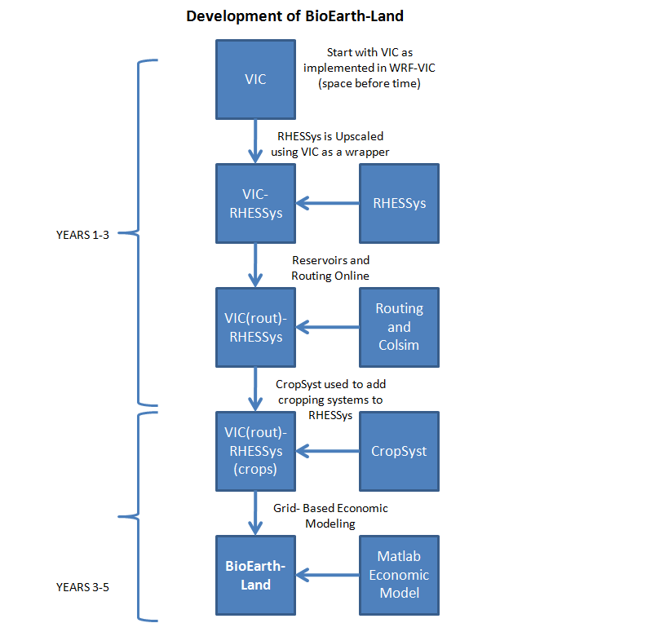
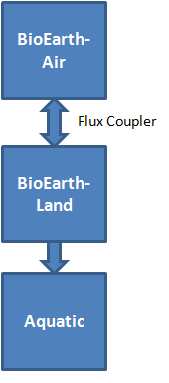

Slide 5
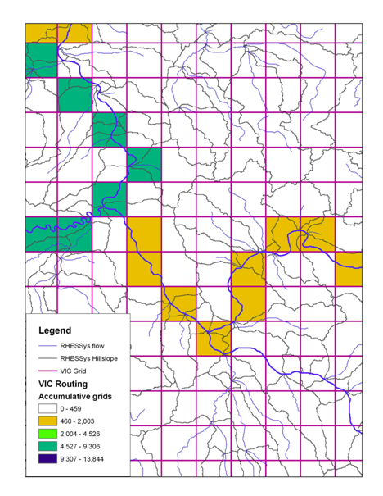
Progress Towards VIC/RHESSys Integration
VIC grids converted from latitude/longitude boxes to watershed boundaries (see right)
RHESSys will run at a finer resolution (for each “patch”) within each VIC grid, handling all hydrology
RHESSys patches resolution will be finer within riparian areas and coarser in upland areas; these scales are one of our research questions
Patches will be sub-divided statistically to increase computational efficiency (i.e., the patches can be bigger)
RHESSys will route flow within the VIC grid; a separate routing algorithm will be used to route flow contributed from the VIC grids

Slide 6
Progress in Dataset Development and Offline Simulations
1) 3-arc (about 90 meters) resolution DEM data over the Pacific North West; delineation of watershed boundaries with different size/levels;
2) 1-km resolution aggregated CDL 2010 (Cropland Data Layer) data sets, each grid has fractional area of different crop types and natural vegetations;
3) Generated metdata for running RHESSys from VIC input met data;
4) Improved VIC by introducing an option that outputting whole region’s daily results as one single arc/info ascii format grid file which increased the overall computational efficiency by about 70%;
5) Added a sub-routine in RHESSys to read netcdf format metdata;
6) Made a simulation with VIC for the period of 1915-2006 over the PNW.

Slide 7
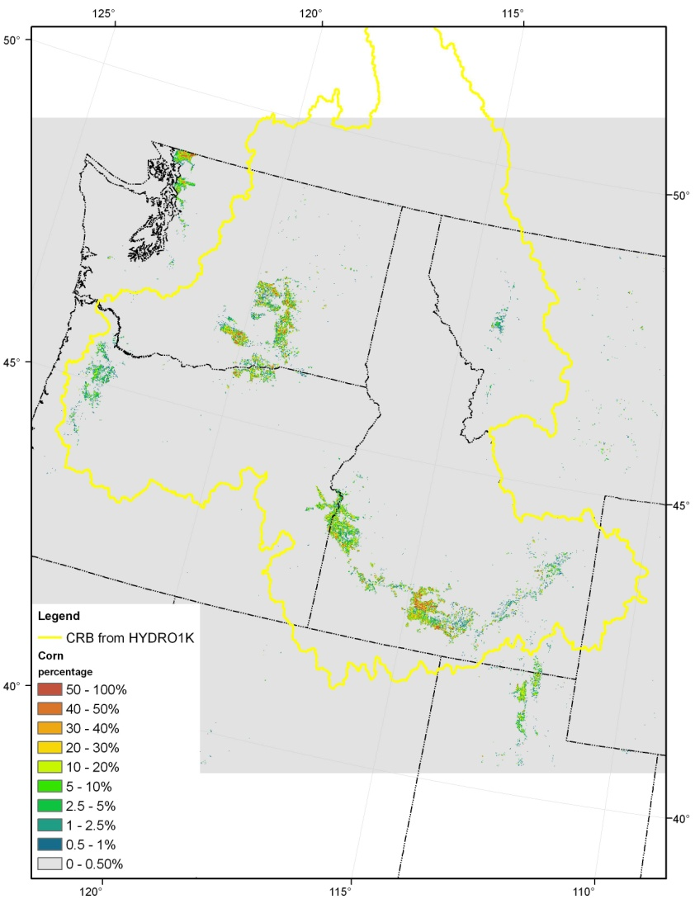
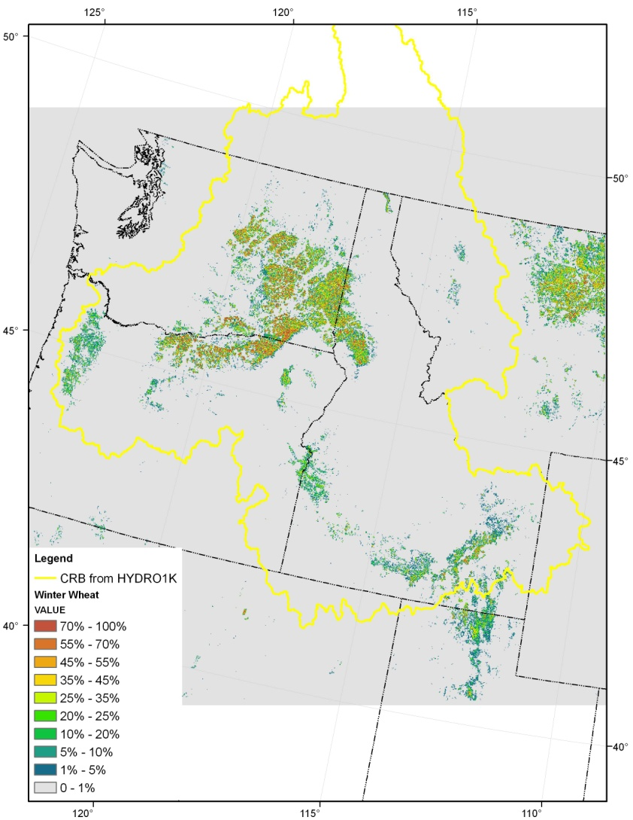
Fractional vegetation cover with 1-km resolution aggregated from CDL data sets (Left: Corn; Right: Winter Wheat)

Slide 8
Offline VIC simulations: the anomalies of evapotranspiration, runoff, and precipitation during 1915-2006 over the Pacific North West (PNW)

Slide 9
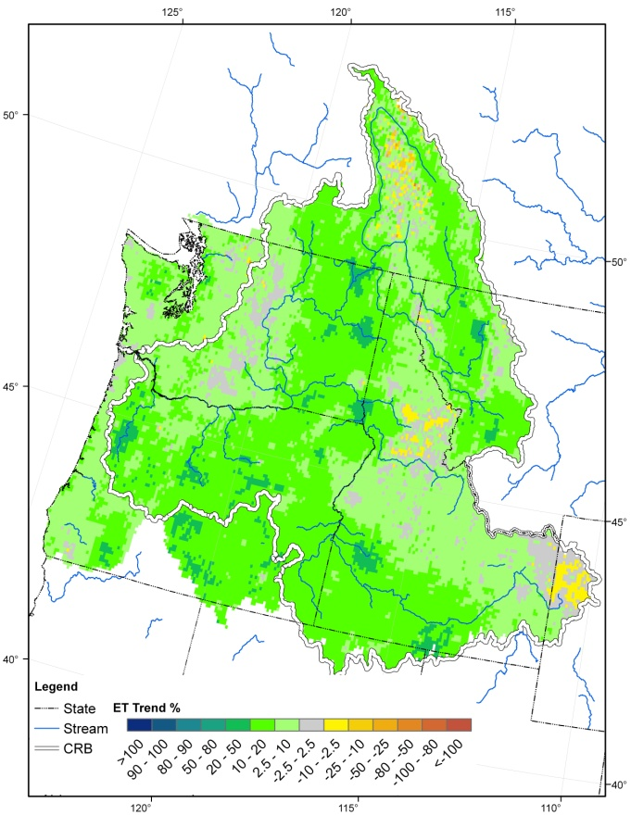
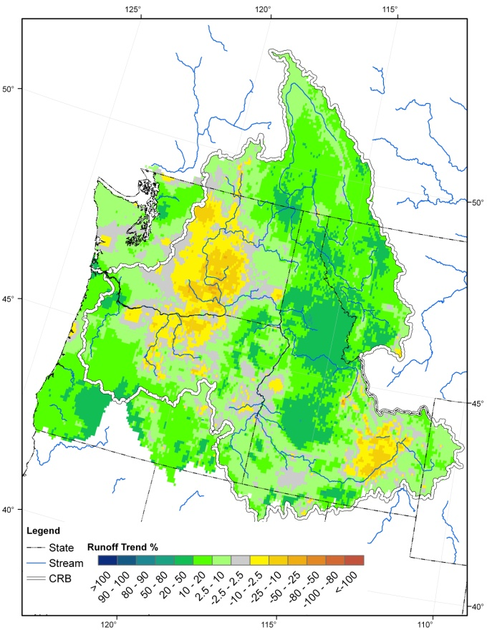
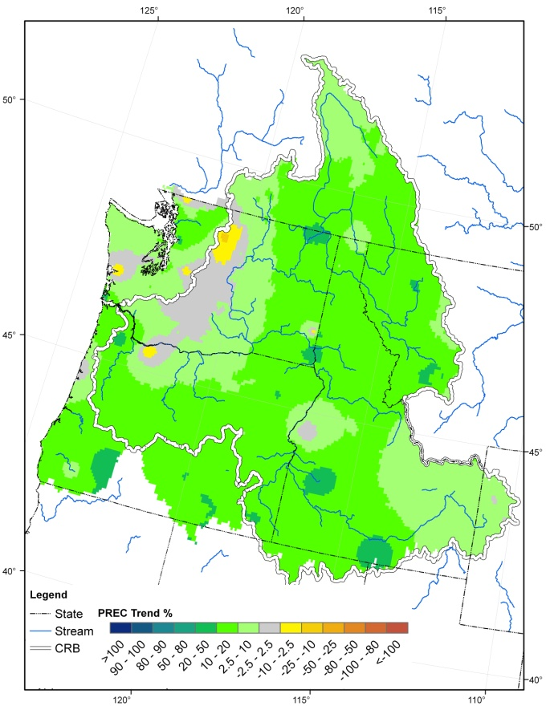
Offline VIC simulations
ET
Runoff
Precipitation
Linear trend of estimated annual ET and runoff with VIC model and the precipitation during 1915-2006 (unit: percentage)

Slide 10
N Fixation Addition to RHESSys
Current N cycle structure
  PSN: Farquhar model + Soil mineral N available
    Soil mineral N-avail: decomposition + uptake - denitrification
    Potential PSN (farq): N demand
    If soil mineral N-avail < N demand, reduce PSN
N fixation addition
    If soil mineral N-avail < N demand, use some PSN to fix N
    At carbon costs, as a function of temperature

Slide 11
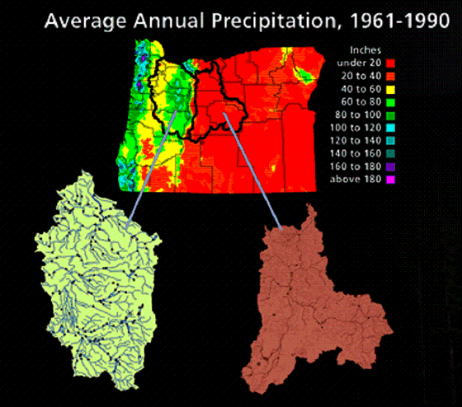
Proposed Focus Sites
Wet Site: Mckenzie River Watershed
(Willamette River Basin)
Dry Site: TBD
(Deschutes River Basin)
Willamette
McKenzie
Deschutes
Modified after “Map of Oregon showing the Willamette and Deschutes Basins” (http://pnwho.forestry.oregonstate.edu/site/index.php)

Slide 12
Proposed Research Questions
The following four questions are in line with our milestone for 2012-2013 and each will lead to a publishable manuscript:
  Q1: How does global warming affect N retention and export at a local/patch scale (no redistribution)?
  Q2: How does watershed redistribution of moisture and N input impact N retention and export under global warming?
  Q3: How does model implementation scale affect N retention and export and the sensitivity of N processes?
  Q4: How do changes in species and disturbances in watersheds affect N retention and export?

Slide 13
NEWS Progress (from John)
Headway in the development of a global, seasonal NEWS-DIN model, and the insights gained from that effort can be put to use in BioEarth.
We are also starting to dig into the Millennium Assessment scenario runs for the continental US, an effort which is also relevant to BioEarth, though not a BioEarth product.
Optimistic about prospects for bringing a good student on board for NEWS/BioEarth work in the fall of 2012.

Slide 14
Samples of Student Dissertation Topics

Slide 15
Kirti Rajagopalan, Civil and Environmental Engineering
Research Area: Impacts of climate change on irrigated agricultural productivity in the CRB
Progress on her dissertation (and towards BioEarth) through our Dep. of Ecology CRB supply and demand forecast

Slide 16
Tools Developed
Developed the coupled crop hydrology model VIC-CropSyst
Developed an integrated framework involving the biophysical components VIC-CropSyst, reservoir modeling and water rights information for curtailment as well as an economics component Columbia River Basin (some components for the Washington part of the Columbia River Basin only)

Slide 17
Application of tools
To project 2030s water supply and irrigation demand in the Columbia River Basin
To study the effect of climate change as well as economics on irrigated agriculture (crop water demand, cropping pattern and crop yield) at the watershed scale.
Lessons learned will be used the improve the biophysical model components for BioEarth

Slide 18
Biophysical/Economic Modeling Integration
Inputs
Modeling Steps
Outputs
Biophysical Modeling:
VIC-CropSyst, Reservoirs, Curtailment
Future Climate Scenario
Water Supply
Irrigation Water Demand
Unmet Irrigation Water Demand
Effects on Crop Yield
Adjusted Crop Acreage
Selective Deficit Irrigation
Water Management Scenario
Crop Yield (as impacted by climate and water availability)
Economic Scenario
Economic Modeling:
Agricultural Producer Response

Slide 19
Keyvan Malek, Biological Systems Engineering
Research Area: VIC-CropSyst Case study on Yakima River basin irrigated agriculture
  Climate change impacts
  Impacts of irrigation efficiency on distribution of crop yield across the basin
  Nitrogen efficiency
Progress towards BioEarth development
  Generation of soil file over PNW and western US domains (with Roger Nelson)
  Improvement of VIC-CropSyst dynamic coupling

Slide 20
Julian Reyes, Civil and Environmental Engineering (NSPIRE)
Research Question: How does atmospheric deposition of nitrogen (ADN) change in response to global change, and how does this deposition affect nutrient cycling and potential C sequestration in the terrestrial biosphere?
  Investigation through empirical and process-based models (i.e. RHESSys, nitrogen dilution curve)
  In particular, look at grasslands and forests.

Slide 21
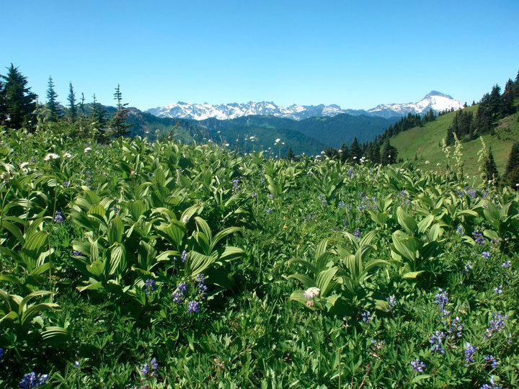
Justin Poinsatte, Biological Sciences
What are the impacts of atmospheric nitrogen deposition on sensitive, high elevation ecosystems?
Influences on:
  Biogeochemical cycling
  Vegetation physiology
  Microbial and vegetation communities

Slide 22
Research Approach
  Ecosystem Modeling
    Determine response to N deposition
  Field Experiment
    N deposition levels as field treatments
  Analysis
    Parameterize model with field data
    Compare model output to field measurements

Slide 23
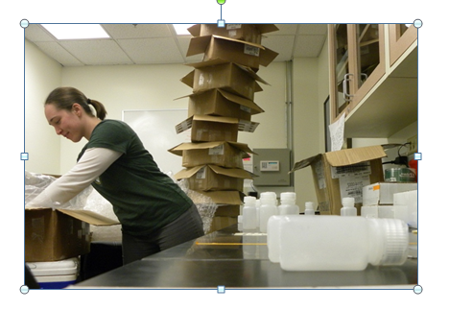
N Deposition Sarah Anderson, Biological Sciences
Research Questions
What are the sources contributing N deposition?
What are the patterns of N transport?
What effect does this have to sensitive ecosystems in the Pacific Northwest?
Goal: Answer these questions by combining stable isotope techniques & regional modeling
Current Projects Analyzing
NADP Samples & Snowpack
δ¹⁵N
δ¹⁸O
Δ¹⁷O

