Slide 1
Descriptions of a few land surface models
VIC: large-scale land surface hydrology
ColSim: reservoir operations
CropSyst: cropping systems

Slide 2
Variable Infiltration Capacity (VIC) Model
Large-scale land surface hydrology

Slide 3
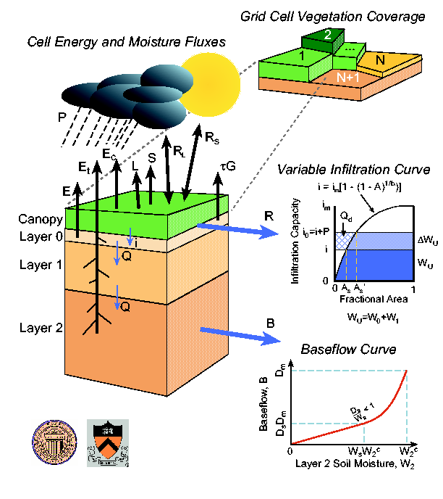
Model Overview
Solves surface water balance and energy balance at every time-step
Spatially distributed at pixel resolution.
Sub-grid variability in vegetation and elevation handled statistically.

Slide 4
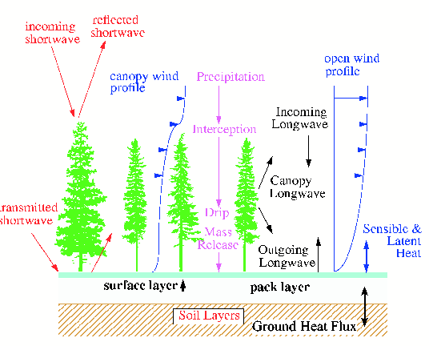
Snow Model
2-layer snow model
First layer used for surface energy balance
Second layer is used for mass balance
Snowmelt solved using energy balance
Snow dynamics in canopies also included

Slide 5
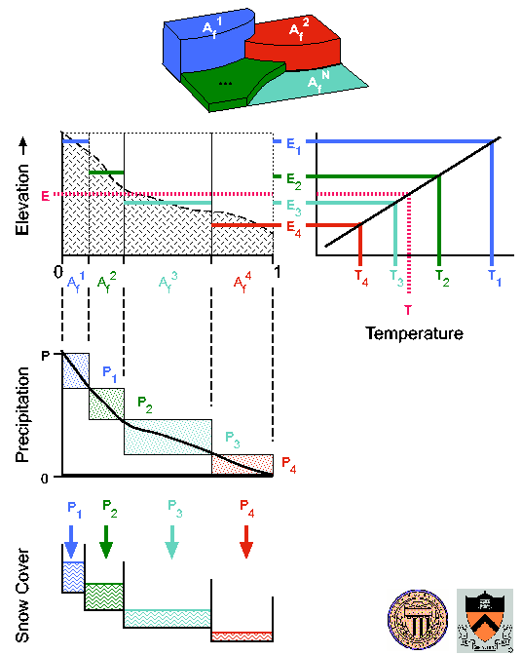
Snow Elevation Bands
Sub-grid variability in elevation can be defined to improve snow module
Lapse rates (change with elevation) can be defined for both temperature and precipitation

Slide 6
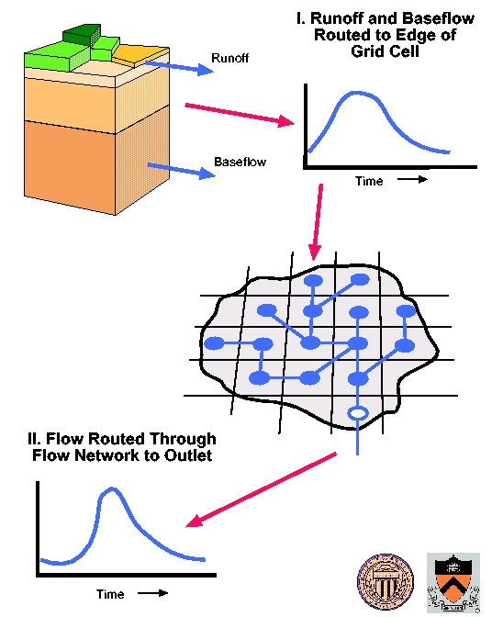
Flow Routing
Each pixel in VIC is run independently from other pixels.
Each pixel contributes runoff and baseflow.
The routing model is a stand-alone model that accumulates these contributes and calculates streamflow.

Slide 7
Spatial/Temporal Scales
Spatial:
  Finest application: 1/16th degree (each pixel is about 6 km on a side)
  Coarsest application: 2 degree (each pixel is about 200 km on a side)
  Resolution (on the fine side) is limited by the assumption that there is no lateral subsurface transport between pixels
  Spatial extent applications: moderately large to continental scale
Temporal
  Resolution is 1hr to 24hr
  Period is unlimited (usually run for >30 years)

Slide 8
VIC Inputs/Outputs
Inputs:
  Transient: precipitation, temperature, wind speed, radiation, relative humidity
  Static: vegetation, soil, and elevation properties
Outputs:
  Fluxes: runoff, baseflow, evapotranspiration, sublimation, energy fluxes, …
  States: soil moisture, snow depth, snow density, intercepted water, surface/subsurface temperatures, …

Slide 9
Architecture
Time before space: Each pixel is run independently from every other pixel for the entire simulation period.
Lateral surface transport is performed using the “offline” routing model
Computing Language: C on linux/unix platform

Slide 10
Examples of Anticipated Issues
“time before space” architecture: we will need to restructure to “space before time” for integration with atmospheric processes.
Sub-grid distributions of elevation and vegetation: vegetation classes are automatically uniformly distributed among each elevation class. For integration with ecohydrology, will need to define the sub-grid relationship between vegetation and elevation.

Slide 11
Common Applications
Intended as land surface model for Global Climate Models (GCMs)
Most common use: projecting changes in water availability under climate change or land use change
Attribution of observed changes in streamflow, snowpack, and other hydrologic states/fluxes
Data assimilation, etc…

Slide 12
ColSim
Reservoir Operations

Slide 13
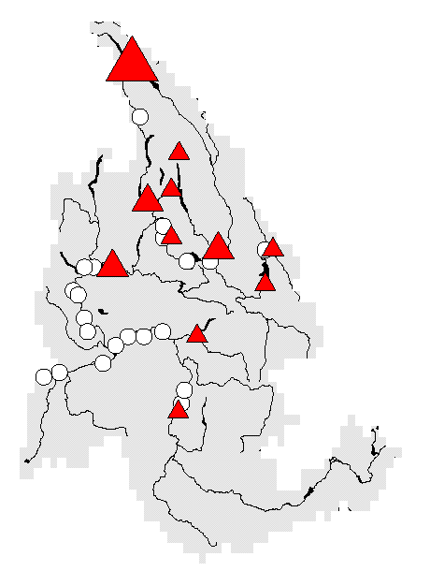
The Reservoir Model (ColSim)
Reservoir Operating Policies
Physical System
of Dams
and Reservoirs
Reservoir Storage
Regulated Streamflow
Flood Control
Energy Production
Irrigation Consumption
Streamflow Augmentation
VIC Streamflow Time Series
Slide courtesy of Alan Hamlet

Slide 14
Other Details
Architecture: currently runs in a system dynamic model framework (Stella) (will need to be recoded to C for direct integration with VIC)
Monthly time-step
Largest reservoirs only

Slide 15
CropSyst
Cropping Systems

Slide 16
CropSyst Description
Developed by Claudio Stockle at WSU
Multi-year, multi-crop, daily time-step crop simulation model
Operates at the point scale
Available for Windows, Unix, Linux
Accessible via Internet:
  manuals, programs, documentation
  listserver
  related programs

Slide 17
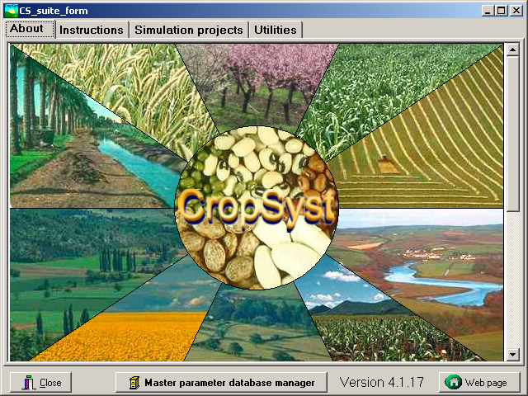
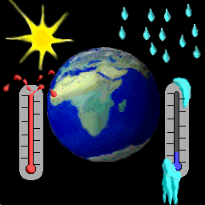
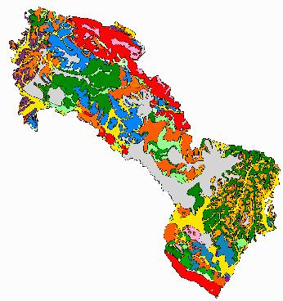
Simulation-based Estimation and Projection
Soil
Cropping systems
Weather
Management
ClimGen
Biomass
Arc GIS – CropSyst
Cooperator
Yield
ΔSOC
Water, N, C balance
GHG emissions

Slide 18
CropSyst- Farm LCA Interaction
Biomass
Yield
ΔSOC
GHG emissions
LCA Software

Slide 19
Input and Output Fluxes of CropSyst
Evapotranspiration
Volatilization
GHG emissions
Rainfall
Management
irrigation
tillage
fertilization
residue
CROP
Runoff
Soil loss
SOIL
SOC
Percolation
Leaching
Water rise

Slide 20
CropSyst includes simulation of:
Crop development and growth (unstressed or stressed)
Simulation of growth under increased atmospheric CO₂ concentration
Water and nitrogen balance
Salinity
Residue fate
Soil erosion by water
Carbon sequestration
Greenhouse gas emissions (CO₂ and N₂O)

Slide 21
Crop processes in CropSyst
development
growth
light interception
net photosynthesis
biomass partitioning
Canopy expansion
root deepening
senescence
water uptake
nitrogen uptake
water stress
nitrogen stress
temperature stress

Slide 22
Soil Processes in CropSyst
residues fate
O.M. mineralization
nitrogen transformations
soil erosion
ammonia volatilization
N₂O emission
water infiltration
water redistribution
runoff
evaporation
percolation
solutes transport
salinization
nitrogen fixation

Slide 23
VIC/CropSyst Integration

Slide 24
Summary of Integration
CropSyst developed for “online” VIC runs is simplified. Not all of the management details are retained.
Currently crops can only be water stressed. Nutrient stress will be added as part of BioEarth.
CropSyst is invoked for each “sub-grid” in VIC that is occupied by a crop.
Communication between models is at a daily time-step.

Slide 25
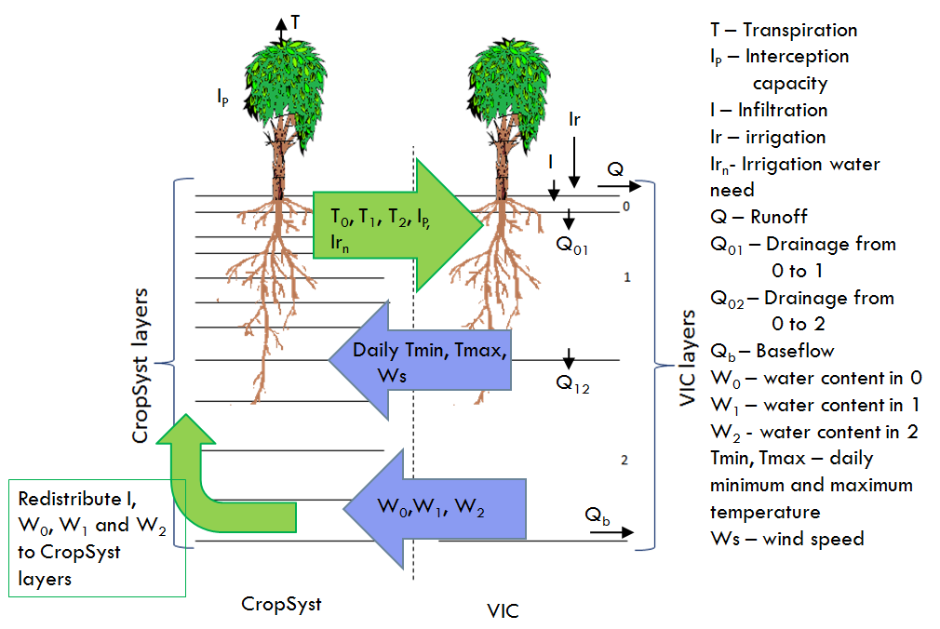
Sharing of States/Fluxes

Slide 26
Questions?

Slide 27
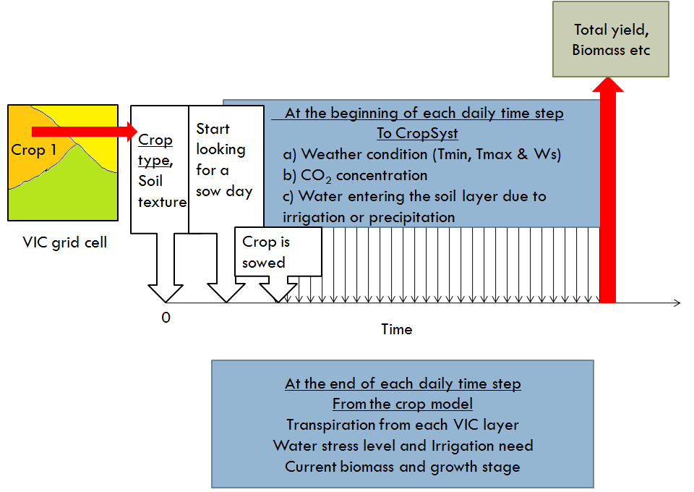
Sharing of States/Fluxes

Slide 28
Crop parameters
Crop Input Parameters
Parameters in red: High priority, to be supplied by agronomists
Parameters in blue: Medium priority, to be supplied by agronomists or Claudio
Parameters in black: Provided by Claudio
Type of crop
Is this a C3 crop? (Y/N) (alternative is C4 crop)
Is this a root crop? (T/F)
Is this a tree-fruit crop? (T/F)
Is this a perennial crop? (T/F)
Is this a grain crop? (T/F)
Is this a vegetable crop? (T/F)
Initialization
Root depth at emergence (m)
Planting depth (m)
Crop Growth
Radiation-Use Efficiency at High VPD (g/MJ PAR)
Water-Use Efficiency at 1 kPa (g/kg)
Slope of Water-Use Efficiency Function of VPD (negative)
Optimum Mean Daily Temperature for Growth (C)
Morphology:
Initial Canopy Cover (0 to 1, unitless)
Maximum Canopy Cover (0 to 1, unitless)
Green Canopy Cover at Maturity (0 to 1, unitless)
Total Canopy Cover at Maturity (0 to 1, unitless)
Leaf Water Potential That Begin Reducing Canopy Expansion (J/kg)
Leaf Water Potential That Stops Canopy Expansion (J/kg)
Maximum Rooting Depth (m)
Root Growth Sensitivity to Stress (0 - 1)
Notes:
These are the Crop parameters which Claudio has developed and are crop specific. For VIC-crop framework, there will be one such file for each every crop simualted. Claudio has color coded them based on their priority.
This was an old slide and I do not know how much of this has actually gone into the model we are currenly working with.

Slide 29
Crop parameters..contd
Crop Development:
Base Temperature for Development (C)
Maximum Temperature for Development (C)
Typical Planting Date (DOY)
Day of 50% Emergence or budbreak (fruit trees) (DOY)
Day of 50% budbreak if chill requirements not satisfied (DOY)
Day of 50% Flowering (DOY)
Typical Date Beginning of Grain Filling, Root Bulking or Fruit Growth (DOY)
Typical Date of Maturity or Crop Harvestable (DOY)
Typical Date Full Canopy Growth is Reached (DOY)
Typical Date for the Beginning of Canopy Senescence (DOY)
Plant-Water Relations
Crop Evapotranspiration Coefficient (assuming full ground shading at noon)
Maximum Water Uptake (mm/day)
Leaf Water Potential at the Onset of Stomatal Closure (J/kg)
Wilting Leaf Water Potential (J/kg)
Harvest
Unstressed Harvest Index
Maximum Fraction of Carbon Translocated to Grains
Tree-Fruit Crops Only
Fresh Mass Fruit Load (kg/ha)
Fraction of Solids in Fruits (0-1)
Chill Requirements (Number of hours below 10 ºC)
Average Date for Beginning of Dormancy (DOY)
Crop Response to Elevated Atmospheric Carbon Dioxide
Baseline CO2 Concentration in the experiment (ppm)
Elevated CO2 Concentration in the experiment (ppm)
Biomass Gain Ratio due to CO2 Increase in the experiment (unitless)

